Slide 1

Fake News Detection Using BERT
NIKITA AGARWAL
NITIN NEGI
POORNIMA
PRASANNAJEET

Slide 2
INTRODUCTION
This project explores the use of BERT-based transformer models to detect fake news in digital media. Fake news spreads rapidly online, influencing public opinion and societal trust. Traditional detection methods struggle with nuanced language and context, making advanced NLP techniques essential.
We fine-tune DistilBERT, a lightweight variant of BERT, on a balanced dataset of real and fake news articles. The model captures contextual semantics to classify news accurately, aiming to provide a scalable and efficient solution for misinformation detection.

Slide 3

MOTIVATION
Information Age Challenges
Need for Automation
Manual fact-checking is impractical at scale; intelligent systems using NLP and deep learning are essential for real-time fake news detection.
Social media enables instant information sharing but also accelerates fake news dissemination, impacting politics, health, and social trust.
Rise of Transformers
BERT’s bidirectional context understanding surpasses traditional ML models, offering improved accuracy in detecting nuanced misinformation.

Slide 4
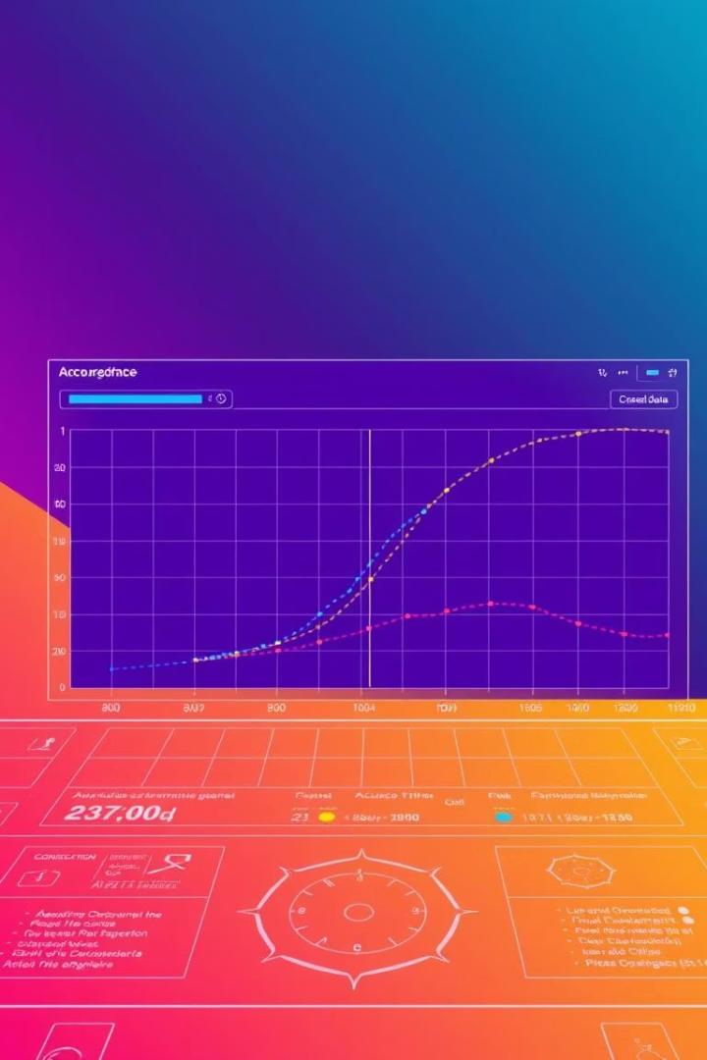
Objectives and Key Outcomes
Model Development
Fine-tune DistilBERT on labeled news data to classify articles as real or fake with high accuracy.
Performance Evaluation
Use metrics like accuracy, precision, recall, F1-score, and confusion matrices to validate model effectiveness.
Deployment Readiness
Save model and tokenizer for future integration into real-time applications and research extensions.
Research Contribution
Provide a scalable, interpretable foundation for combating misinformation using transformer-based NLP.

Slide 5
Literature Review: Evolution of Fake News Detection
Traditional Machine Learning
Deep Learning Advances
Transformer Models
DistilBERT
BERT and variants capture bidirectional context, outperforming earlier models in fake news classification tasks.
A smaller, faster BERT variant retaining most accuracy, enabling efficient deployment in resource-constrained settings.
Methods like Naive Bayes, SVM, and Random Forest used handcrafted features but lacked semantic understanding.
RNNs, LSTMs, and CNNs improved feature extraction but struggled with long-range dependencies and context.

Slide 6

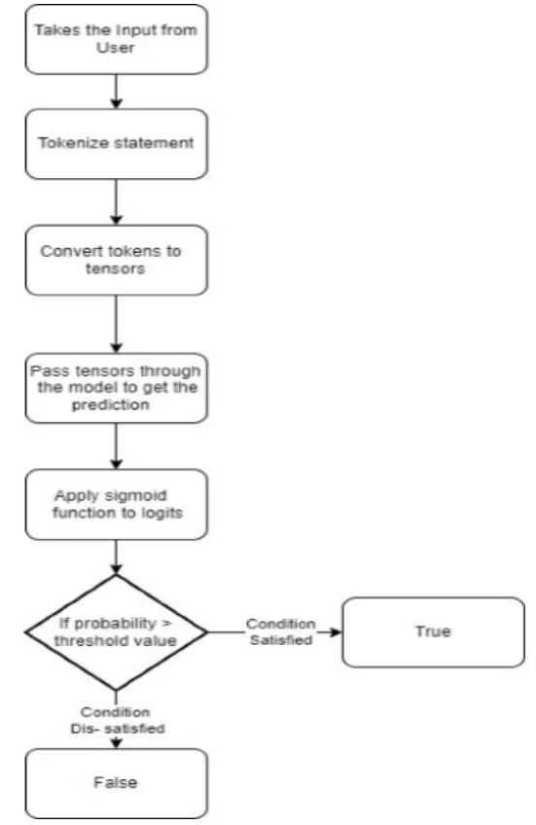




Project Description and Methodology
Data Collection
Use Kaggle dataset with labeled fake and real news articles, balanced for binary classification.
Preprocessing
Clean text, tokenize using DistilBERT tokenizer, pad/truncate sequences to fixed length.
Model Fine-tuning
Train DistilBERT with binary cross-entropy loss and AdamW optimizer on tokenized data.
Evaluation
Assess accuracy, precision, recall, F1-score, and visualize confusion matrix and ROC curves.

Slide 7





Code Implementation and Tools
Python 3.10
PyTorch
Transformers Library
Primary programming language for data processing and model training.
Deep learning framework used for building and fine-tuning DistilBERT.
Hugging Face library for pre-trained models and tokenizers.
Matplotlib & Seaborn
Visualization tools for plotting confusion matrices and performance metrics.

Slide 8
Data Analysis and Insights
Dataset Overview
Textual Patterns
Balanced dataset with 250 fake and 250 real news articles, combined and shuffled for training.
Fake news often uses sensational keywords like "breaking" and "report," while real news focuses on official terms like "president" and "election."
Average article length ~350 words
Max length ~1800 words
Fake news shows stronger sentiment polarity
Max token length set to 256 for model input
Distinct unigram and bigram patterns differentiate classes

Slide 9

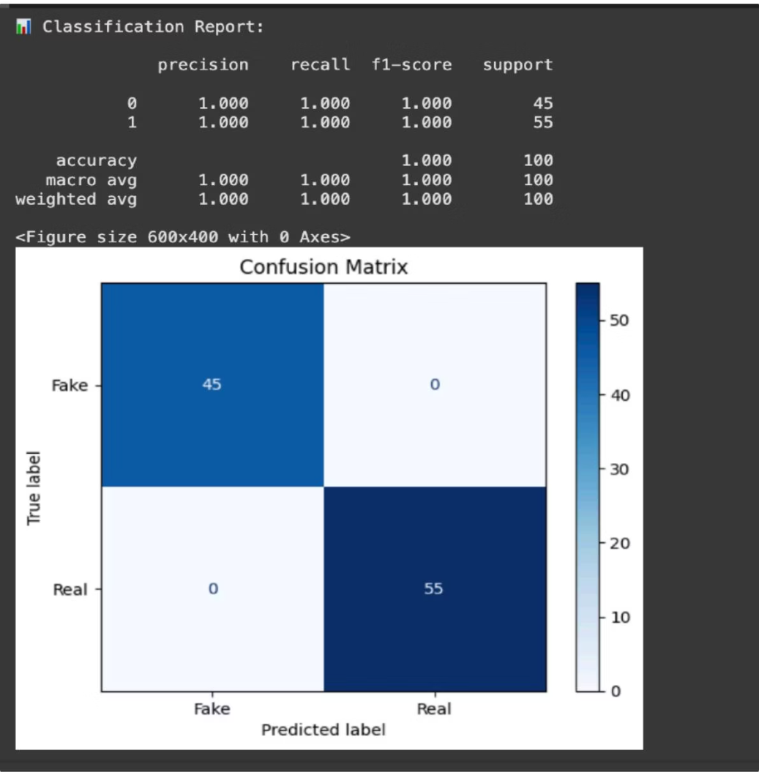
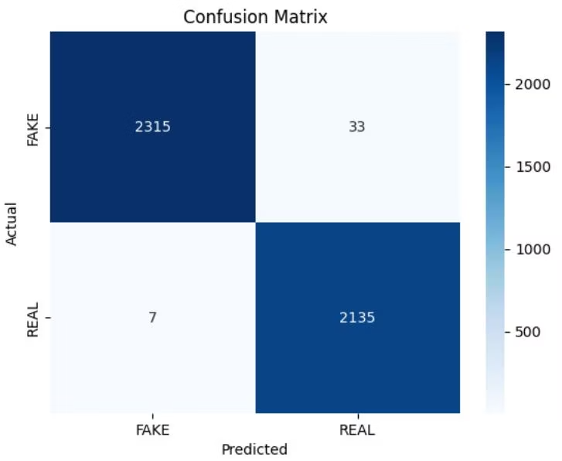
Model Performance and Results
High Accuracy
Confusion Matrix Highlights
Model achieved 96% accuracy with balanced precision and recall, indicating reliable classification.
Low misclassification rates: 4 false positives and 5 false negatives, showing strong practical performance.
ROC and Precision-Recall
AUC-ROC score of 0.97 demonstrates excellent separability between fake and real news classes.

Slide 10

Future Enhancements and Conclusion
Expand Language Support
Integrate multilingual models like mBERT to detect fake news in diverse languages.
Real-Time Integration
Connect with live news streams and social media APIs for continuous monitoring.
Explainable AI
Incorporate tools like LIME or SHAP to provide transparency in model decisions.
Deployment
Develop web/mobile apps and browser extensions for public access and verification.
The project demonstrates that transformer-based models like BERT provide a powerful, scalable solution for fake news detection. With further enhancements, such systems can significantly contribute to combating misinformation and promoting media integrity globally.

